Slide 1
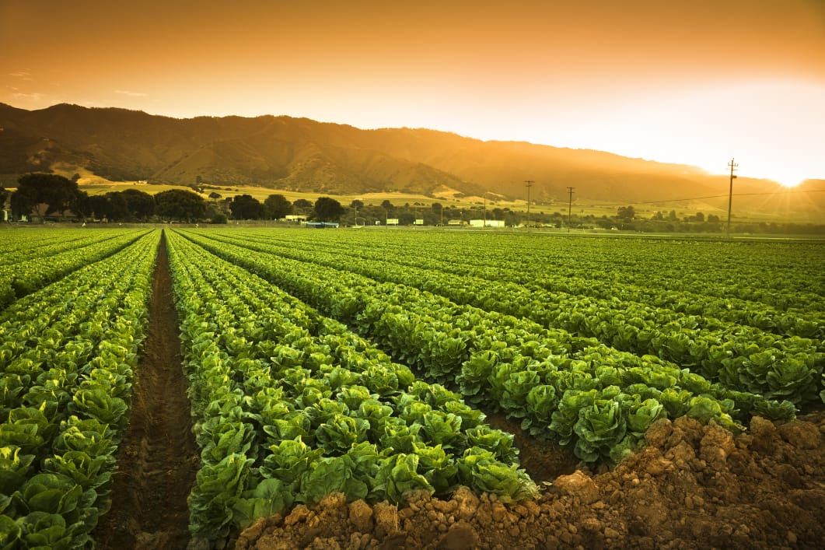
SDG > 12
Responsible production and consumption
CSE Group G9

Slide 2
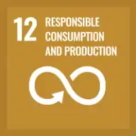
Ensure sustainable consumption and production patterns
Preserve the precious

Slide 3
Team
Done under the vision of:
Mrs. Logesswari….AP/CSE assistant professor
And
Dr . S.Rekha …Chemistry Associate Professor… S&H Department
.
S. Anila Chowdary
111520104130
M .Charitha
111520104093
M .yamini 111520104094
S .Swarna 111520104132

Slide 4
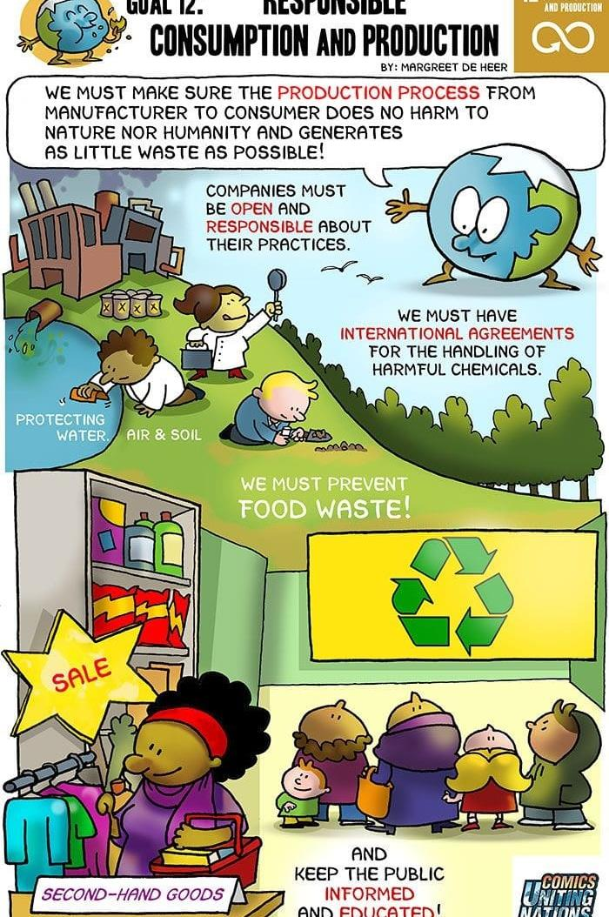
Introduction
For many years we are increasing the daily consumption and we are also aware of impact of overusing of it will effects consumption . Which society , economy , health as well as a whole planet. daily Responsible consumption and production is the way of consuming and producing the products for the people must takes into account the foundations of sustainable development.which are making better or buying better-which means giving importance to greener products.and manufacturing better-consuming better.which means for more sustainable development we have to reduce the wastings.Throwing away better which means taking products or anything to recycling in particular.following four R'-Reduce,Recycle,Reuse,Recover.
We have to responsible in consumption and production in many particular things some important are responsible consumption and production of food . everyone try to avoid as much as possible food waste . Favour of ecological consumption . Resonsible in consumption and production of daily needs as the production must go with peoples demand and people such as consumers must go with situation demands . like that we can maintain consumption and production. Buying or manufacturing the people needs which have to be environmental , social and economic impact . Responsible consumption means the consumption is not only ecofriendly but also it includes both social and economic impacts of consumption . In the same way responsible production also involves the production of goods and services must be in ethical way which means reducing the waste and pollution in the production process and minimizing the usage of natural resources . Not only that it also have the impact of in increasing the country's economy.

Slide 5

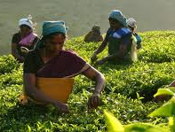
Our aim of this project is to calculate the net rate of production and consumption at a certain place ,our ultimate goal is to preserve the precious food, through our programme we are able to balance both production and consumption.
ABSTRACT:

Slide 6
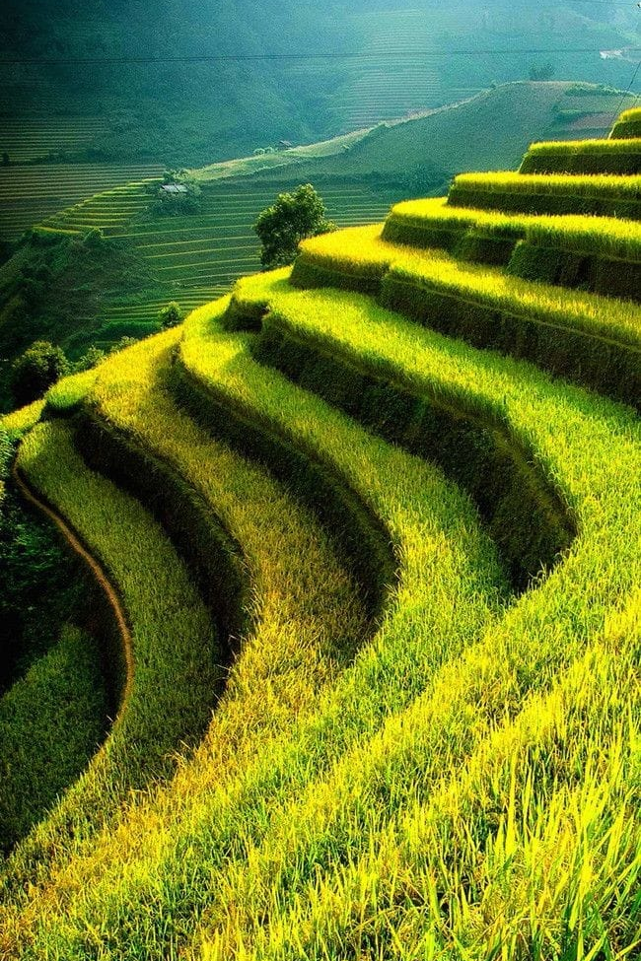
Source code
print("********* PRESERVE THE PRECIOUS ************ ")
name_place=input("Enter the name of the place where production to be caculated : ")
number_farmers=int(input("Enter the number of farmers present in that place: "))
number_people=int(input("Enter the number of people living in that place : "))
tpdn=0
tcns=0
list_farmers=[]
list_people=[]
for i in range(number_farmers):
list_farmers.append(int(input("enter the present farmer production for one year in measure of quintals : ")))
print("total production is : ",sum(list_farmers))
tpdn=sum(list_farmers)
avgpro = tpdn//number_farmers
for k in range(number_people):
list_people.append(int(input("enter the present family consumption for one year in measure of quintals : ")))
tcns=sum(list_people)
print("total consumption of the people in that city : ",sum(list_people))
avgcns = tcns//number_people
print("the average production for one year in this city: ",avgpro)
print("the average consumption for one year in this city: ",avgcns)
netrate = avgpro-avgcns
print("The amount of crop that remained waste: ",netrate)

Slide 7
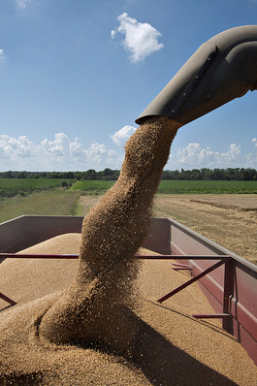
output
********* PRESERVE THE PRECIOUS ************
Enter the name of the place where production to be caculated : tamil nadu
Enter the number of farmers present in that place: 5
Enter the number of people living in that place : 4
enter the present farmer production for one year in measure of quintals : 40
enter the present farmer production for one year in measure of quintals : 50
enter the present farmer production for one year in measure of quintals : 60
enter the present farmer production for one year in measure of quintals : 21
enter the present farmer production for one year in measure of quintals : 90
total production is : 261
enter the present family consumption for one year in measure of quintals : 10
enter the present family consumption for one year in measure of quintals : 20
enter the present family consumption for one year in measure of quintals : 50
enter the present family consumption for one year in measure of quintals : 82
total consumption of the people in that city : 162
the average production for one year in this city: 52
the average consumption for one year in this city: 40
The amount of crop that remained waste: 12

Slide 8
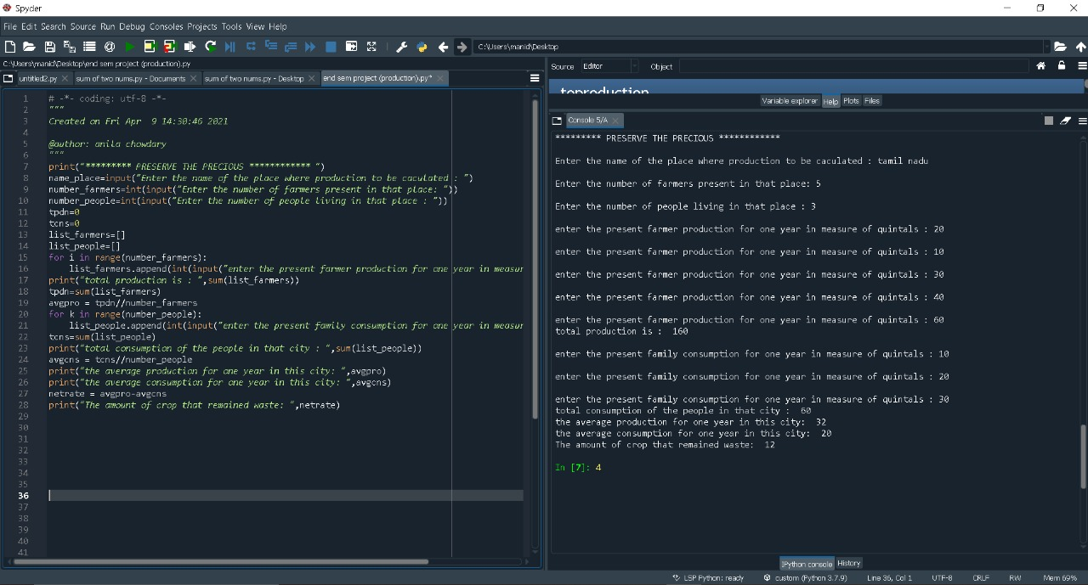

Slide 10

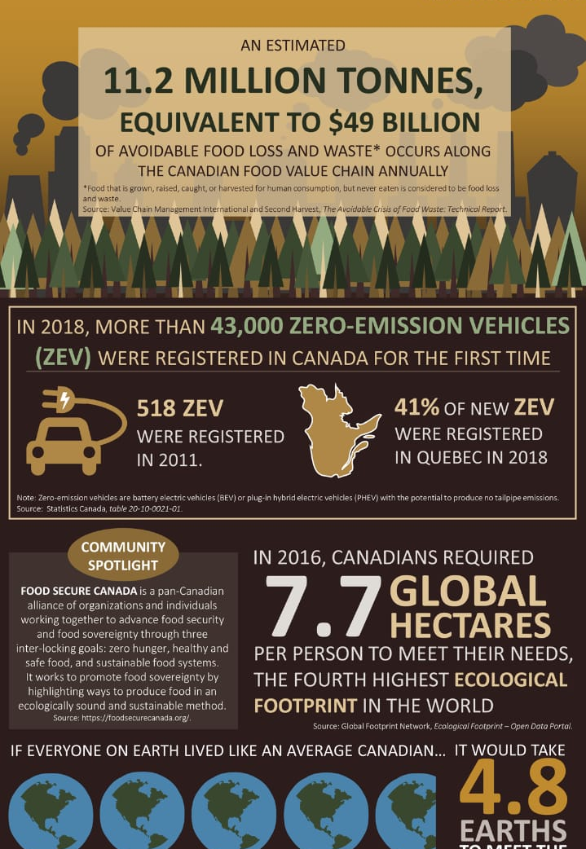
Analysis:
Hence we analysis the total world Crop production some 11 percent(13.4 billion ha)
That is 36% is used. Totally 4.62 billion acres of cropland on earth. China is the first place in crop production. It has 7% of the arable land and with that, they feed 22% of the world's population. Next comes to the United States United States is known for its agriculture science and provides some advanced agriculture technology in the world. Next comes to Brazil and then India. Next coming to all over crop production in the world is 36% per year. Next coming to the all over Crop consumption in the world is 31% per year. Next coming to the wastage of the crop production all the world According to FAO each year approximately one - third of all food produced for humans consumption is being wasted.

Slide 11
To production and consumption in responsibility :
Responsible production and consumption is a broad concept to explain . It not only an environmental element .but also an economic ,social and health dimensions.it is depend upon consumer needs and sensitivity of consumer .and also producer thoughts or ways to fullfill consumer needs . some producers and consumers focus on ecological side and other on their choices and some other are economy . Responsible consumption and production would meet some of the criteria which are
Production or consumption of green products:
The impact of environment of green products have to be less which means both should be respecting the environment and biodiversity . Which prevents pollution , deforestation and depletion of natural sources.
Production or consumption which have positive economic impact:
Goods were producing or consuming would have to create more jobs and have to increase economic integration of people.and to promote employees of people standard of living.

Slide 12


Production or consumption of healthy products:
Food products or any goods have to manufactured with more hygiene standards and every product most have healthy nutritional composition . After that disposing of any product also be in a safe way without damaging hygiene standard of people.
TARGET 12.2
TARGET 12.1
Implement
The 10-year
sustainable consumption
and
production
Sustainable management and use of natural resources

Slide 13

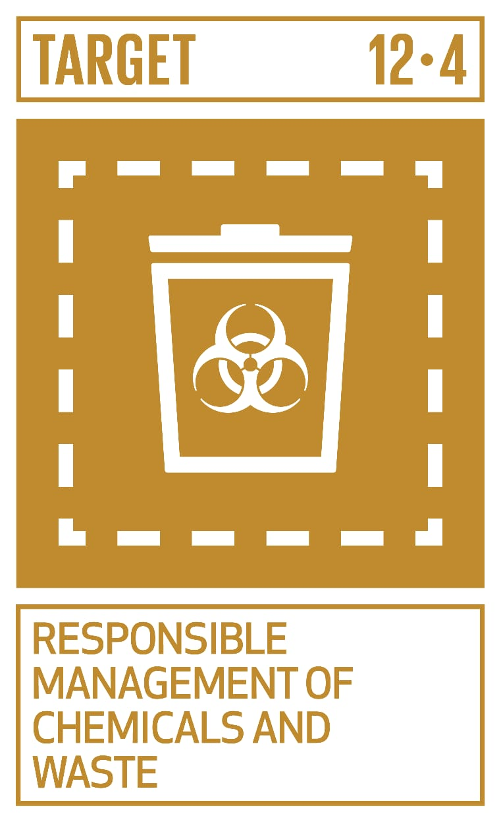
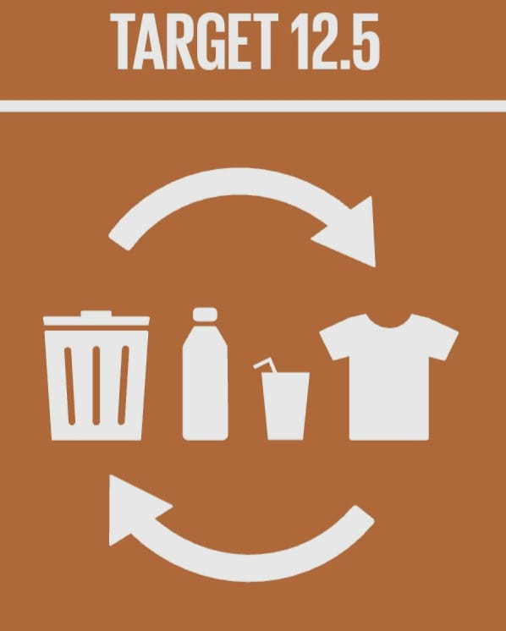

Production or consumption must be in follow of ethical and moral principle: Production and consumption of goods must be in ethical and moral way in respecting animal welfare and individual freedom and also reducing malpractices or any corruption
TARGET 12.3
Subtitle
Have global per capita food waste
Sustainably reduce waste generation

Slide 14

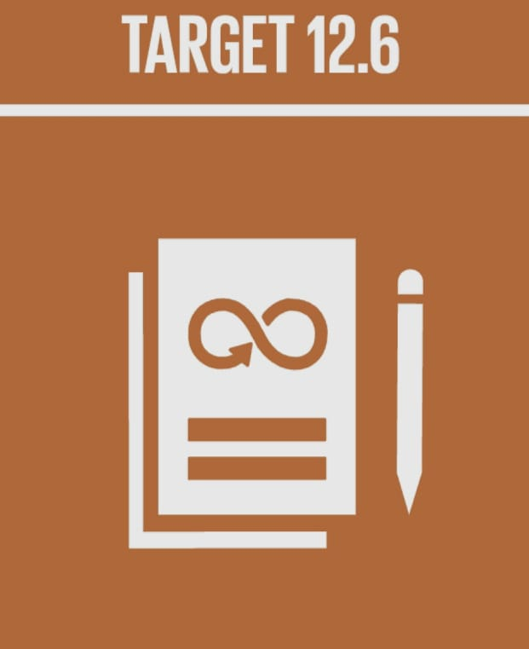
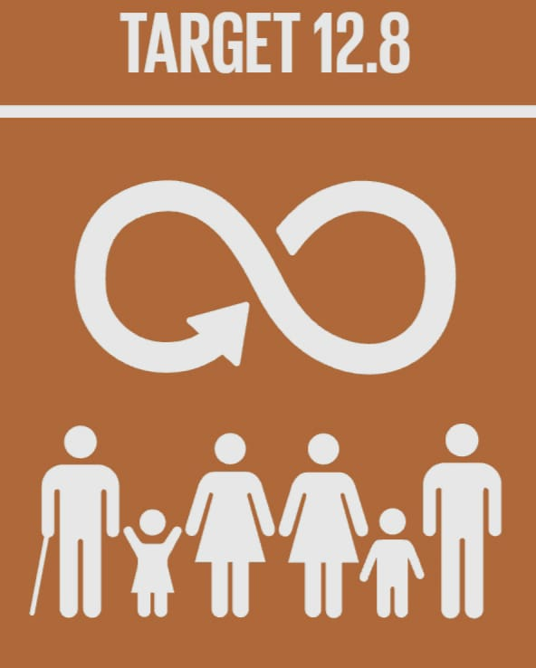

By maintaing some ethics and values.we can maintain interest of consumers and can maintain economy of country.
Encourage companies to adopt sustainable practices and sustainability reporting
Promote sustainable public procurement practices
Promote universal understanding of sustainable lifestyles
TARGET 12.7

Slide 15
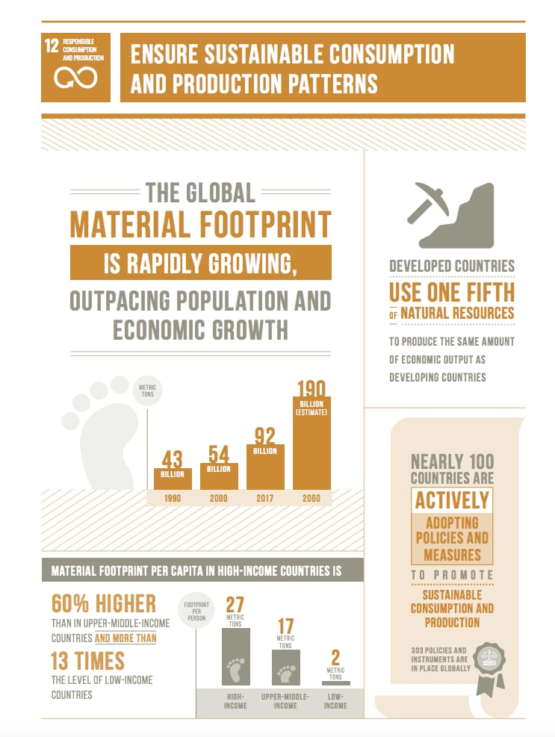
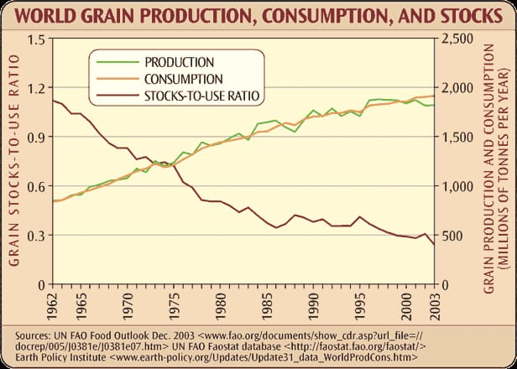
Indian food economy is one of the important sector.
Food production is increasing per year , due to factors such as food inflation ,inefficient disturibution systems and storage systems ,India is facing downfall in its food maintenance.
CONCLUSION

Slide 16
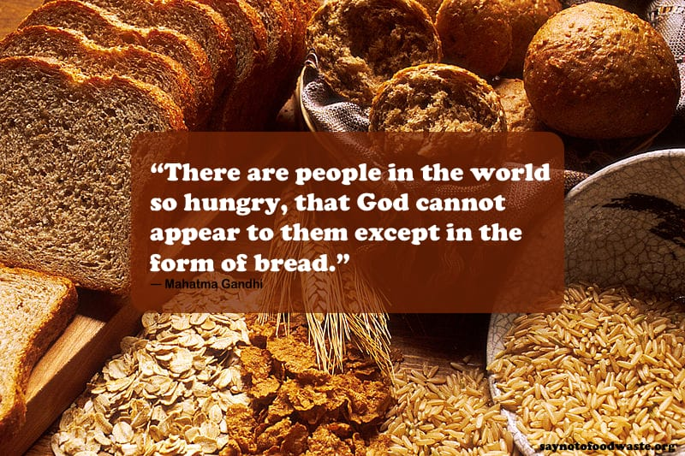
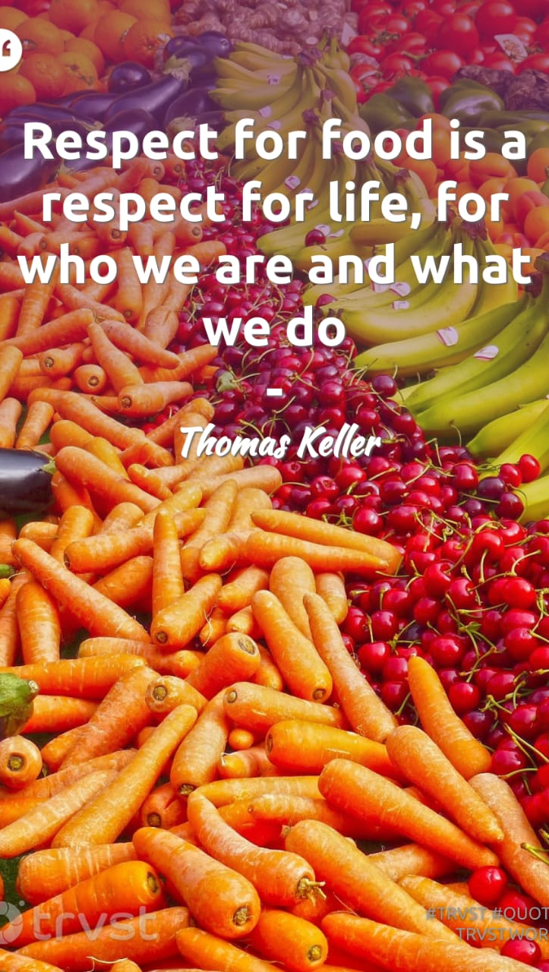
Thank you

